Slide 1
Autoignition of n-Butanol at Elevated Pressure and Low- to Intermediate-Temperature Using a Rapid Compression Machine
Bryan Weber
Prepared for
Master’s Thesis Defense
July 21, 2010

Slide 2
Outline of Presentation
Background
Literature Review
Experimental Apparatus
RCM Test Matrix
Check Mixture Composition
RCM Results and Discussion
Summary

Slide 3
Background (1)
Environmental and geopolitical concerns are driving demand for a new type of fuel
This new fuel should be renewable and able to be produced domestically
Biofuels, and in particular alcohols, fit these criteria very well
Current technology requires blending biofuel with conventional fuel
Ethanol is one of the most popular biofuels for transportation use

Slide 4
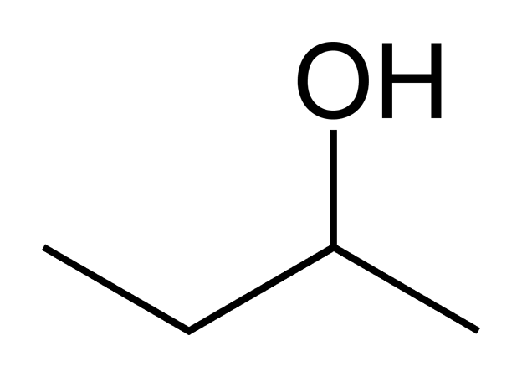
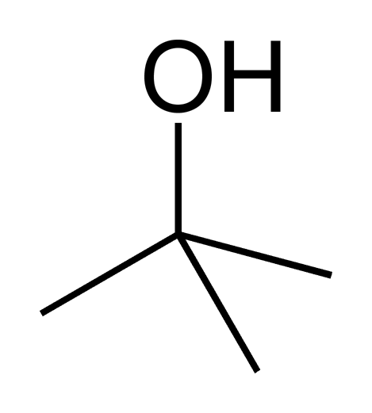
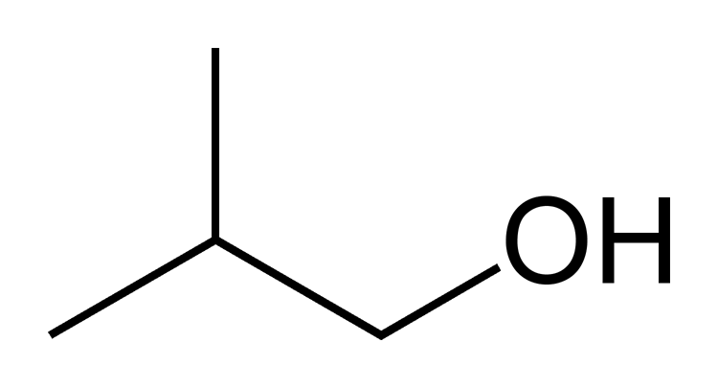
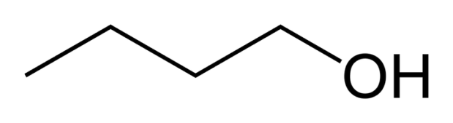
Background (2)
Butanol is a biofuel
Can be produced from bio-waste fermentation in bacteria genetically designed to increase butanol yield
Formula – C₄H₉OH (C₄H₁₀O)
4 isomers
n-butanol bio-butanol 1-butanol
sec-butanol
tert-butanol
iso-butanol

Slide 5
Background (3)
Butanol is a good test case for developing new fuels
Butanol is the smallest alcohol with primary, secondary and tertiary alcohol groups
The chemistry of butanol can be extended to higher alcohols

Slide 6
Background (4)
n-Butanol has several advantages over ethanol:
Higher specific energy
Less miscible with water
Less corrosive to engine parts and pipes
Lower vapor pressure
These properties enable:
Using current oil and gasoline pipelines for fuel transport
Higher mixing ratios with gasoline
Improved volumetric fuel economy (mpg) over ethanol
Reducing evaporative emissions and risk of explosion

Slide 7
Background (5)
Fuel | Lower Heating Value [MJ/kg] | Volumetric Energy Density [MJ/L] | Research Octane Number, RON | Motor Octane Number, MON
Gasoline | 42.5 | 32 | 92-98 | 82-88
Methanol | 19.9 | 16 | 136 | 104
Ethanol | 28.9 | 20 | 129 | 102
1-Butanol | 33.1 | 29 | 96 | 78
J.T. Moss, et. al, “An Experimental and Kinetic Modeling Study of the Oxidation of the Four Isomers of Butanol,” The Journal of Physical Chemistry A, vol. 112, 2008, pp. 10843-10855.

Slide 8
Background (6)
Yaws, C.L. “Chemical Properties Handbook.” McGraw-Hill, 1999

Slide 9
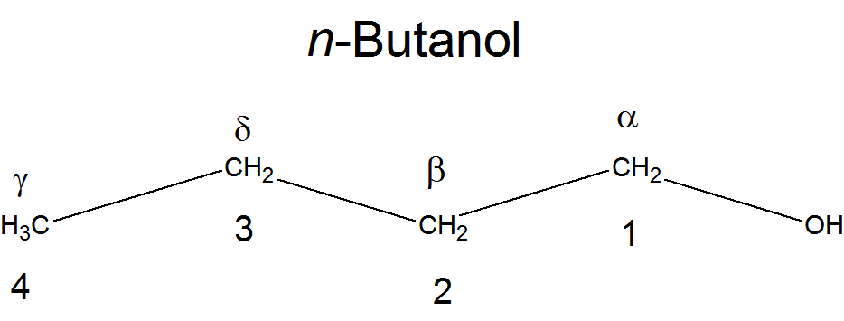
Background (7)
Carbons in the skeleton are numbered by their distance from the alcohol group

Slide 10
Literature Review (1)
~15 studies directly relevant to butanol kinetics.
Dagaut et al.^{1,2} have done JSR experiments at 1 and 10 atm, and laminar flame speed and opposed-flow diffusion flame experiments for n-butanol.
Zhang et al.³ performed a motored engine study with n-butanol and reported combustion intermediates in a temperature range similar to the one considered here
1. S.M. Sarathy, P. Dagaut, et. al., “An experimental and kinetic modeling study of n-Butanol combustion,” Combustion and Flame, 2009.
2. P. Dagaut, et. al., “A chemical kinetic study of n-Butanol oxidation at elevated pressure in a jet stirred reactor,” Proceedings of the Combustion Institute, vol. 32, 2009, pp. 229-237.
3. Y. Zhang, A.L. Boehman. “Oxidation of 1-butanol and a mixture of n-heptane/1-butanol in a motored engine.” Combustion and Flame. In Press, 2010. doi:10.1016/j.combustflame.2010.04.017

Slide 11
Literature Review (2)
Black et al.⁴ (NUI) have done shock tube studies for n-butanol from 1100-1800 K and 1, 2.6 and 8 atm over φ=0.5, 1, 2 and fuel mole percents of 0.6%, 0.75% and 3.5%.
4. G. Black, et. al., “Bio-Butanol: Combustion properties and a detailed kinetic model,” Combustion and Flame, vol. 157, 2010 pp. 363-373.

Slide 12
NUI Mechanism
243 species
1446 reactions
Mechanism based on updated C₄ chemistry from the same group, with an added n-butanol sub-mechanism taken from EXGAS and modified as appropriate
Validated against shock tube data
Ignition delay validation range:
T = 1100 – 1800 K
P = 1 – 8 atm

Slide 13
Literature Review (2)
Black et al.⁴ (NUI)
Harper et al.⁵ (MIT) have created a mechanism for n-butanol based on the previous experiments, a pyrolysis experiment and a butanol-doped methane flame experiment
4. G. Black, et. al., “Bio-Butanol: Combustion properties and a detailed kinetic model,” Combustion and Flame, vol. 157, 2010 pp. 363-373.
5. M. Harper, W. Green, et. al., “Comprehensive Reaction Mechanism for n-Butanol Pyrolysis and Combustion”, unpublished manuscript.

Slide 14
MIT Mechanism
189 species
2022 reactions
Created automatically from Reaction Mechanism Generator, open-source software from MIT
Initial “Seed” Mechanisms:
GRI-Mech (excluding Nitrogen chemistry)
Ethanol mechanism by Marinov (not discussed here)
Validated against JSR, flame, shock tube and pyrolysis data
Ignition delay validation range:
T = 1100-1800 K
P = 1 – 8 atm

Slide 15
Literature Review (2)
Black et al.⁴ (NUI)
Harper et al.⁵ (MIT)
Grana et al.⁶ (Milano) have performed counterflow diffusion flame experiments of n-butanol and iso-butanol and created a reaction mechanism
4. G. Black, et. al., “Bio-Butanol: Combustion properties and a detailed kinetic model,” Combustion and Flame, vol. 157, 2010 pp. 363-373.
5. M. Harper, W. Green, et. al., “Comprehensive Reaction Mechanism for n-Butanol Pyrolysis and Combustion”, unpublished manuscript.
6. R. Grana, et al. “An experimental and kinetic modeling study of combustion of isomers of butanol.” Combustion and Flame. In Press, 2010. doi:10.1016/j.combustflame.2010.05.009.

Slide 16
Milano Mechanism
354 species
10,127 reactions
Includes all four isomers of butanol
Based on C₀-C₁₆ semi-detailed mechanism previously developed by the same group, which includes low temperature chemistry of most species but not the butanols
Validated against JSR, flame, and shock tube data
Ignition delay validation range:
T = 1100-1800 K
P = 1 – 8 atm

Slide 17
Literature Review (2)
Black et al.⁴ (NUI)
Harper et al.⁵ (MIT)
Grana et al.⁶ (Milano)
Moss et al.⁷ (RPI) have done shock tube studies for all four isomers of butanol at 1 and 4 bar and T=1200 to 1800 K over φ=0.5, 1, 2 and fuel mole percents of 0.25%, 0.5% and 1%.
4. G. Black, et. al., “Bio-Butanol: Combustion properties and a detailed kinetic model,” Combustion and Flame, vol. 157, 2010 pp. 363-373.
5. M. Harper, W. Green, et. al., “Comprehensive Reaction Mechanism for n-Butanol Pyrolysis and Combustion”, unpublished manuscript.
6. R. Grana, et al. “An experimental and kinetic modeling study of combustion of isomers of butanol.” Combustion and Flame. In Press, 2010. doi:10.1016/j.combustflame.2010.05.009.
7. J.T. Moss, et. al, “An Experimental and Kinetic Modeling Study of the Oxidation of the Four Isomers of Butanol,” The Journal of Physical Chemistry A, vol. 112, 2008, pp. 10843-10855.

Slide 18
RPI Mechanism
161 species
1250 reactions
Covers all four isomers of butanol
Generated by EXGAS software which creates a 3 part mechanism
Primary mechanism: Initial organic compounds and oxygen
Lumped secondary mechanism: Reactions which consume the products of the primary mechanism, but not contained in the third mechanism
C₀ – C₂ complete reaction base coupled with a C₃ – C₄ unsaturated reaction base
Validated against shock tube data
Ignition delay validation range:
T = 1200 – 1700 K
P = 1 – 4 bar

Slide 19
Literature Review (3)
None of the mechanisms have been validated at lower temperature than 1100 K for ignition delay
None of the mechanisms have been validated at pressures higher than 10 atm (for JSR) or 8 atm (for shock tube)
High-pressure, low-temperature combustion conditions are relevant to several advanced low emissions engines
Homogeneous Charge Compression Ignition (HCCI)
Low Temperature Diesel engines
Comprehensive reaction mechanisms require validation over a wide range of experimental conditions

Slide 20
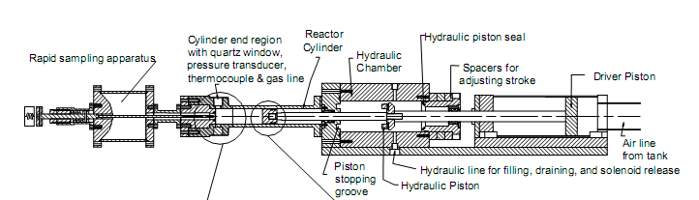
Rapid Compression Machine
Obtain experimental data for autoignition delays at elevated pressures and low-to-intermediate temperatures, using a heated rapid compression machine

Slide 21
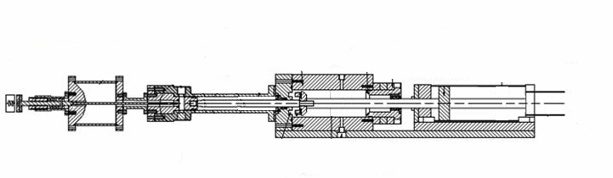
Rapid Compression Machine
Operating Procedure of the Rapid Compression Machine (RCM)
Sampling Chamber
Reaction Chamber
Hydraulic Cylinder
Pneumatic Cylinder

Slide 22
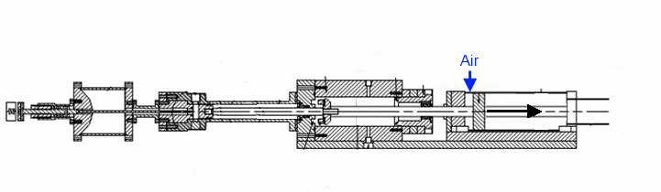
Rapid Compression Machine
Operating Procedure of the Rapid Compression Machine (RCM)
Sampling Chamber
Reaction Chamber
Hydraulic Cylinder
Pneumatic Cylinder

Slide 23
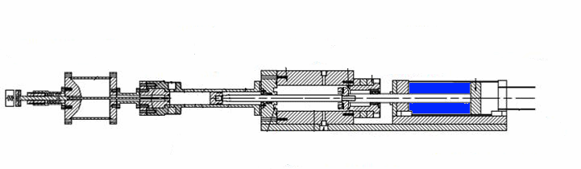
Rapid Compression Machine
Operating Procedure of the Rapid Compression Machine (RCM)
Sampling Chamber
Reaction Chamber
Hydraulic Cylinder
Pneumatic Cylinder

Slide 24
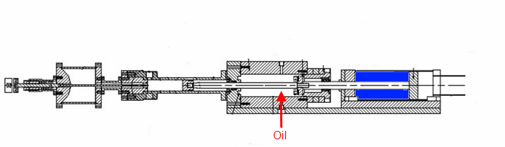
Rapid Compression Machine
Operating Procedure of the Rapid Compression Machine (RCM)
Sampling Chamber
Reaction Chamber
Hydraulic Cylinder
Pneumatic Cylinder

Slide 25
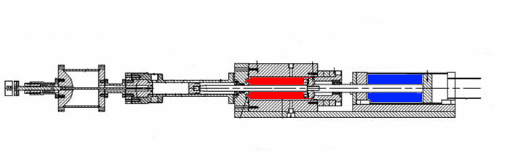
Rapid Compression Machine
Operating Procedure of the Rapid Compression Machine (RCM)
Sampling Chamber
Reaction Chamber
Hydraulic Cylinder
Pneumatic Cylinder

Slide 26
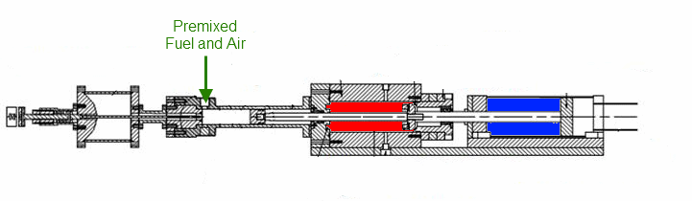
Rapid Compression Machine
Operating Procedure of the Rapid Compression Machine (RCM)
Sampling Chamber
Reaction Chamber
Hydraulic Cylinder
Pneumatic Cylinder

Slide 27
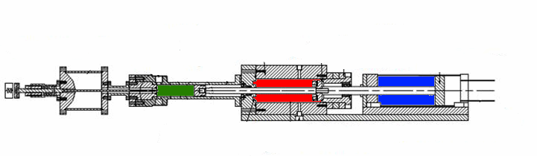
Rapid Compression Machine
Operating Procedure of the Rapid Compression Machine (RCM)
Sampling Chamber
Reaction Chamber
Hydraulic Cylinder
Pneumatic Cylinder

Slide 28
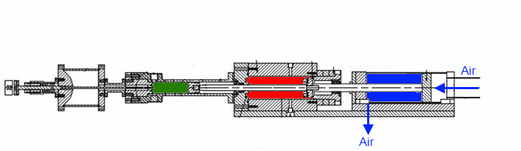
Rapid Compression Machine
Operating Procedure of the Rapid Compression Machine (RCM)
Sampling Chamber
Reaction Chamber
Hydraulic Cylinder
Pneumatic Cylinder

Slide 29
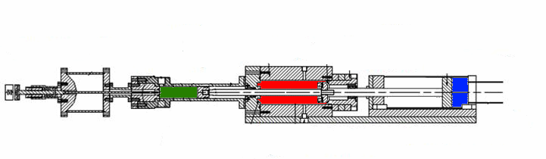
Rapid Compression Machine
Operating Procedure of the Rapid Compression Machine (RCM)
Sampling Chamber
Reaction Chamber
Hydraulic Cylinder
Pneumatic Cylinder

Slide 30
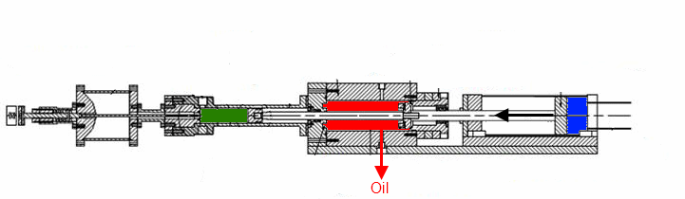
Rapid Compression Machine
Operating Procedure of the Rapid Compression Machine (RCM)
Sampling Chamber
Reaction Chamber
Hydraulic Cylinder
Pneumatic Cylinder

Slide 31
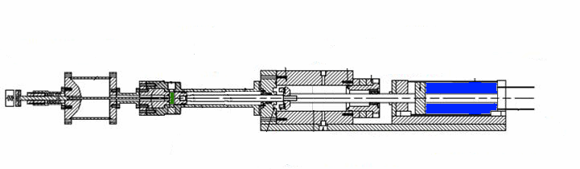
Rapid Compression Machine
Operating Procedure of the Rapid Compression Machine (RCM)
Sampling Chamber
Reaction Chamber
Hydraulic Cylinder
Pneumatic Cylinder

Slide 32
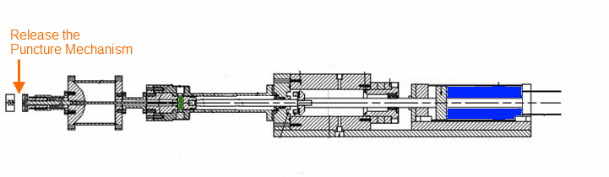
Rapid Compression Machine
Operating Procedure of the Rapid Compression Machine (RCM)
Sampling Chamber
Reaction Chamber
Hydraulic Cylinder
Pneumatic Cylinder

Slide 33
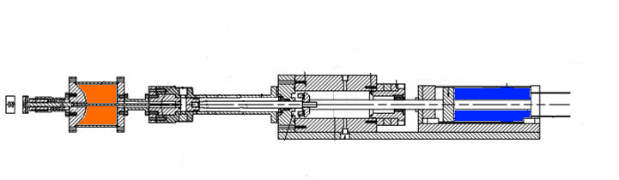
Rapid Compression Machine
Operating Procedure of the Rapid Compression Machine (RCM)
Sampling Chamber
Reaction Chamber
Hydraulic Cylinder
Pneumatic Cylinder

Slide 34
Rapid Compression Machine
Compression Ratio: 8 to 12
Initial Temperature: up to 140°C
Compressed Pressure: 7 to 45 bar
Compressed Temperature: 650-1100K
Compression Time: ~30 ms

Slide 35
RCM Test Matrix (1)
RCM Experimental Conditions for n-butanol
Compressed Pressure: P_{C} = 7, 15, 30 bar
Compressed Temperature: T_{C} = 650-900 K
Fuel/Air Equivalence Ratio: 0.5, 1.0, 2.0
Vary initial O₂ mole fraction at constant initial fuel mole fraction
Vary initial fuel mole fraction at constant initial O₂ mole fraction
Vary Inert Composition: Ar, N₂
Shock Tube Experiments for n-butanol^{4,7}
Fuel Mole Percent = 1-3.5%
Compressed Pressure: P_{C} = 1-8 bar
Compressed Temperature: T_{C} = 1100-1800 K

Slide 36
RCM Test Matrix (2)
Mole Percentage (%) |  |  |  | Equivalence Ratio | Pressure (bar)
n-Butanol | O₂ | N₂ | Ar | φ | P_{C}
2.96 | 20.39 | 76.65 | 0.00 | 0.87 | 30
2.96 | 20.39 | 0.00 | 76.65 | 0.87 | 7
3.38 | 20.30 | 76.32 | 0.00 | 1.0 | 15
3.38 | 20.30 | 76.32 | 0.00 | 1.0 | 30
1.72 | 20.65 | 77.63 | 0.00 | 0.5 | 15
6.54 | 19.63 | 73.83 | 0.00 | 2.0 | 15
3.38 | 40.60 | 56.02 | 0.00 | 0.5 | 15
3.38 | 10.15 | 86.47 | 0.00 | 2.0 | 15
1.69 | 20.30 | 78.01 | 0.00 | 0.5 | 15
6.76 | 20.30 | 72.94 | 0.00 | 2.0 | 15
Oxidizer = Air | Vary O₂ Mole Fraction | Vary Fuel Mole Fraction

Slide 37
Check Mixture Composition (1)
2 goals:
Ensure fuel does not decompose while being held in the mixing tank
Ensure the expected composition is being created in the mixing tank
Use GCMS to identify any decomposition products and quantify the concentration of n-butanol in the mixing tank
Iso-octane is used as an internal standard for quantitative check of the concentration of n-butanol

Slide 38
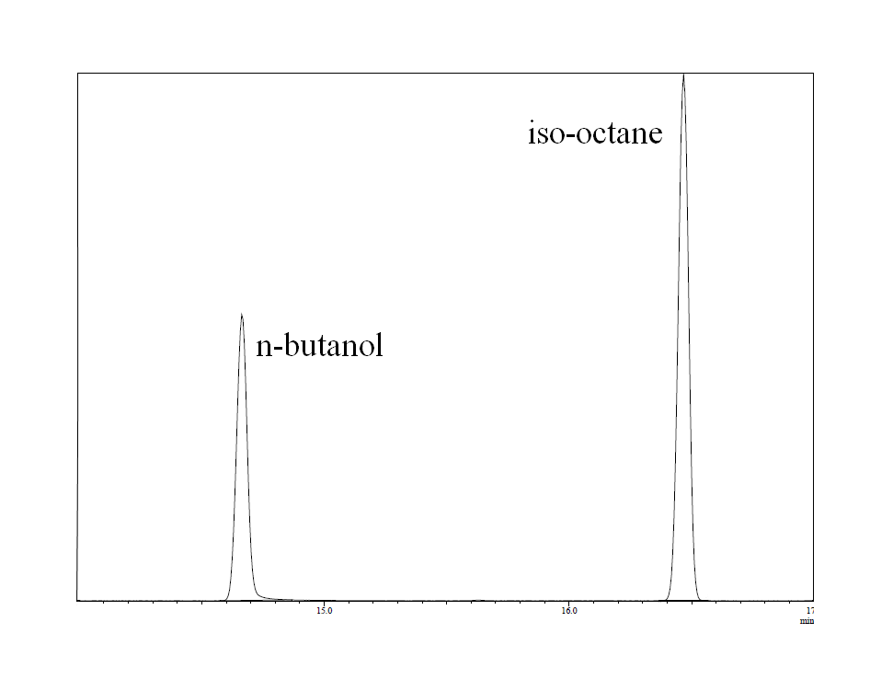
Mixture Composition Check (2)
RTX-1PONA column and temperature program used in this analysis provides good separation of iso-octane and n-butanol

Slide 39
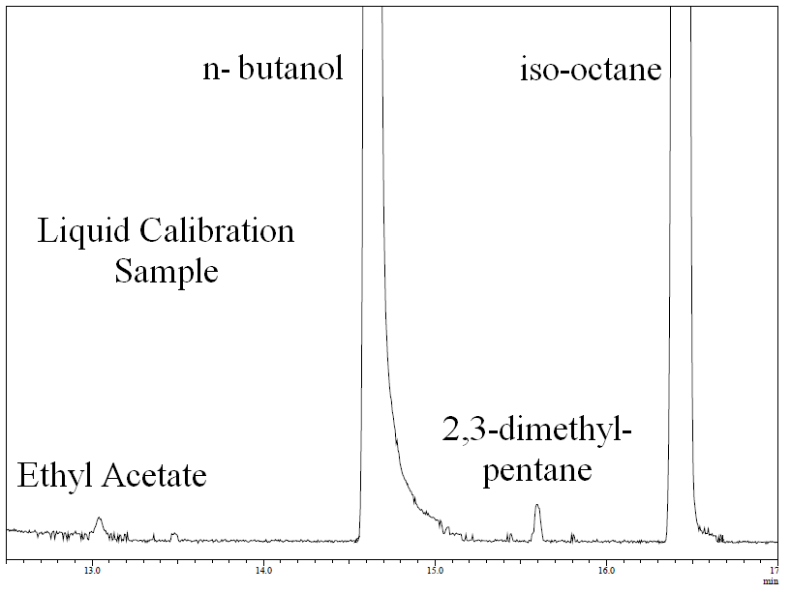
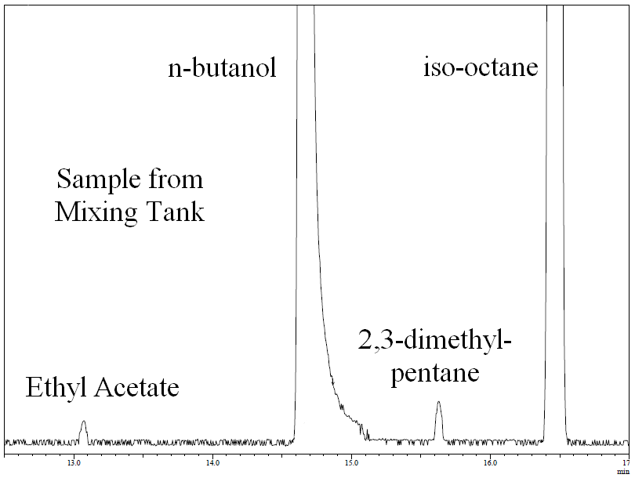
Mixture Composition Check (3)
Liquid standard is created with known concentrations of n-butanol and iso-octane
Small peaks are impurities from n-butanol and iso-octane
There are no extra peaks in the chromatogram of the sample withdrawn from the mixing tank
No decomposition!

Slide 40
Mixture Composition Check (4)
Response factor of n-butanol to iso-octane is calculated based on peak areas from the liquid sample
Response factor and known concentration of iso-octane in the mixing tank are used to calculate the concentration of n-butanol in the mixing tank
Concentration of n-butanol is within 4% of the expected value
 | Response Factor Determination
 | 1-butanol Peak Area |  | 10788294
 | iso-octane Peak Area |  | 20061355
 | Response Factor |  | 0.349076
 | Concentration of 1-Butanol
 | Concentration of iso-octane in mixing tank |  |  | 0.0111
Sample # | 1-butanol Peak Area | iso-octane Peak Area |  | Concentration of 1-butanol
1 | 11165856 | 22824035 |  | 0.015653
2 | 8920318 | 19145108 |  | 0.014908
3 | 18182941 | 35118170 |  | 0.016566
4 | 15224721 | 27259402 |  | 0.01787
5 | 19145886 | 34907200 |  | 0.017549
 |  | Average |  | 0.0165
 |  | Expected |  | 0.0172
 |  | Deviation (%) |  | 4.05

Slide 41
Experimental Reproducibility
Representative trace from at least 6 concordant runs for determining ignition delay.
Pressure is measured; P_{C} is the pressure at Top Dead Center (TDC)
Temperature at TDC (T_{C}) is computed by matching the simulated and experimental pressure traces during compression stroke

Slide 42
Definition of Ignition Delay
End of Compression is determined to be at TDC
The location of inflection point in the pressure trace (found by the maximum of the pressure derivative) identifies the point of ignition
The ignition delay is the time difference between the end of compression and the point of ignition
Notes:
Fix bullet to include TDC

Slide 43
Modeling Ignition Delay (1)
SENKIN/CHEMKIN-III and CHEMKIN-PRO are used to model the ignition delay
RCM Simulation
Reactor volume is a specified function of time
Includes compression stroke and post-compression events
Shock Tube Simulation
Reactor is at constant volume and is adiabatic

Slide 44
Modeling Ignition Delay (2)
During RCM simulations, none of the existing reaction mechanisms ignite within the limits of the experiment

Slide 45
Autoignition of n-Butanol (1)
Increasing compressed temperature reduces ignition delay monotonically
No Negative Temperature Coefficient region found for n-butanol in these experiments

Slide 46
Autoignition of n-Butanol (2)
No two stage ignition found for any condition in these experiments

Slide 47
Autoignition of n-Butanol (2)

Slide 48
Autoignition of n-Butanol (2)
No two stage ignition found for any condition in these experiments

Slide 49
Autoignition of n-Butanol (3)
Shock tube simulations are much longer than experiments
MIT performs the worst; Harper et al. have a new mechanism to be published which corrects a serious error in their rate estimation database

Slide 50
Autoignition of n-Butanol (4)
Increasing equivalence ratio increases reactivity
Shock tube results show the opposite trend⁴
Reactivity dependence on equivalence ratio appears to be a function of temperature

Slide 51
Autoignition of n-Butanol (5)
Similar effect of varying initial oxygen mole fraction and initial fuel mole fraction

Slide 52
Autoignition of n-Butanol (6)
Simulations capture the effect of equivalence ratio in that increasing equivalence ratio increases reactivity
Simulations generally over-predict all results by at least one order of magnitude

Slide 53
Autoignition of n-Butanol (7)
Higher compressed pressure has higher reactivity
Simulations unable to quantitatively capture the pressure dependence in this temperature range

Slide 54
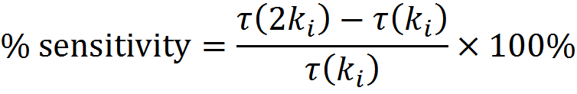
Brute Force Sensitivity
NUI mechanism is most sensitive to the reaction of fuel and HO₂ to form 1-hydroxybutyl
The sensitivity is significantly reduced at higher temperatures

Slide 55
Reaction Path Analysis (1)
A Reaction Path Diagram shows the percent of the reactant destroyed to form the product indicated by the arrow
The percent destruction represents the cumulative destruction of each reactant up to the point in time where the mole fraction of fuel has been reduced 20% compared to the initial value

Slide 56
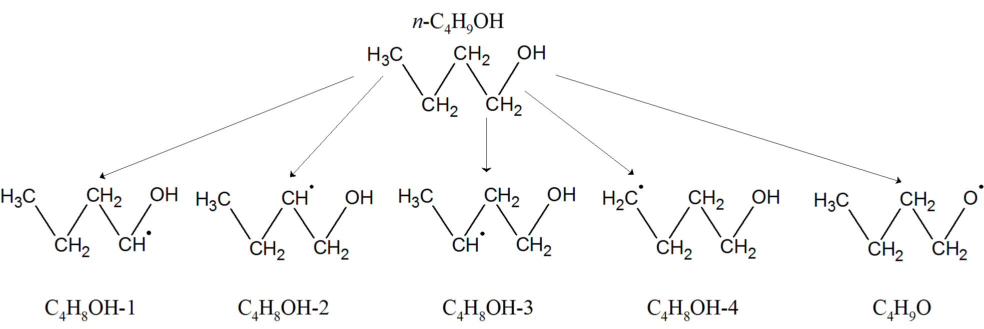
Reaction Path Analysis (2)
n-Butanol (C₄H₉OH) is destroyed by H-atom abstraction producing 5 radicals
These radicals are not equally produced

Slide 57
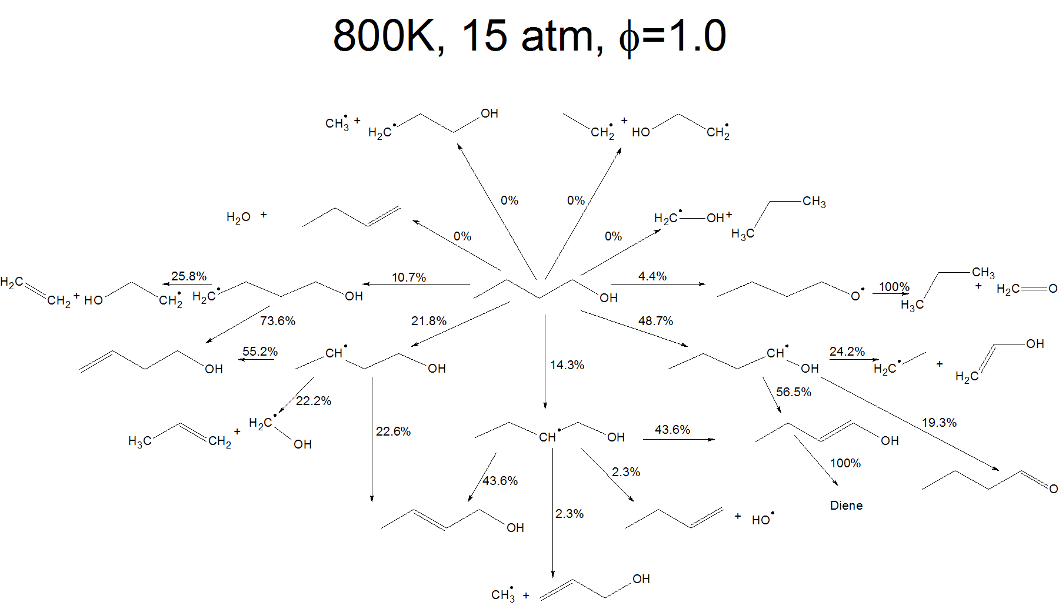
Reaction Path Analysis (3)

Slide 58
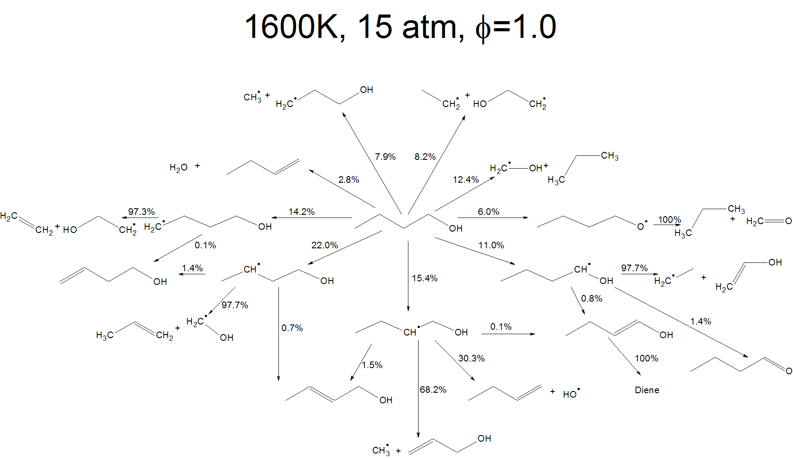
Reaction Path Analysis (4)

Slide 59
Modified Mechanism (1)
Reaction 1353:
Ignition delay becomes constant when the rate of 1-hydroxybutyl formation by R1353 is increased past a certain point
This suggests a new rate limiting step has taken over

Slide 60
Modified Mechanism (2)
Reaction 1353:
The rate of R1353 is multiplied by 1000
Ignition delays are recomputed
Results are close, but the lowest temperature case is still over-predicted by 100 ms

Slide 61
Modified Mechanism (3)
Brute force sensitivity is performed again on the modified mechanism
System is sensitive to the formation of butanal (NC₃H₇CHO)
Formation of 1-hydroxybutyl by R1353 has disappeared from the top ten reactions

Slide 62
Modified Mechanism (4)
Reaction 1353:
Upon first increasing the rate of R1353, production of butanal from 1-hydroxybutyl and fission of 1-hydroxybutyl change drastically
Further increasing the rate does not change the percent directed into each pathway

Slide 63
Modified Mechanism (5)
This analysis suggests butanal formation is the next rate limiting step
The entire pathway of 1-hydroxybutyl formation and destruction is clearly quite important
Further speciation measurements are necessary to determine which pathways are most important

Slide 64
Future Work
Speciation data with Rapid Sampling Apparatus can confirm fuel decomposition pathways
Expand experiments to other isomers of butanol

Slide 65
Summary (1)
Autoignition delay data have been obtained for n-butanol at low to intermediate temperature and elevated pressure using a heated rapid compression machine
Reactivity increased as equivalence ratio, initial oxygen mole fraction or initial fuel mole fraction increase in the temperature range studied
Comparison of experimental results and reaction mechanisms available in the literature showed very poor agreement

Slide 66
Summary (2)
Sensitivity analysis of one reaction mechanism revealed that the rates of certain fuel decomposition reactions strongly affect the ignition delay
Further path analysis highlighted the importance of several fuel decomposition pathways
Speciation data may be required to further improve reaction mechanisms by confirming fuel decomposition pathways
Quantum calculations of the rates of important reactions is warranted based on this work, in particular the 1-hydroxybutyl system

Slide 67
Acknowledgements
Advisor: Dr. Chih-Jen Sung
Research Advisors: Dr. Kamal Kumar, Dr. Yu Zhang
Advisory Committee: Dr. Baki Cetegen, Dr. Tianfeng Lu, Dr. Michael Renfro
Colleagues: Kyle Brady, Apurba Das, Billal Hossain, Xin Hui
Sponsor: Department of Energy, Office of Science, Office of Basic Energy Sciences under Award Number DE-SC0001198

Slide 68
Additional Slides

Slide 69
New MIT mechanism
New MIT mechanism corrects error in reaction rates of H-abstraction from the fuel by HO₂
New MIT mechanism shows much improved results – comparable to the 1000*NUI results

Slide 70
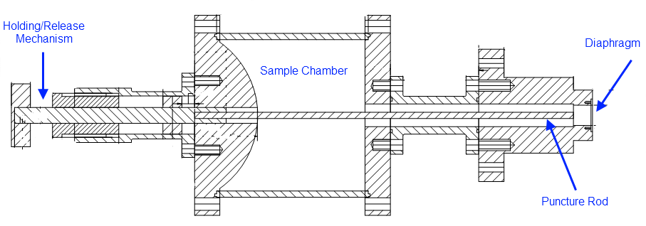
Rapid Sampling Apparatus (1)
Rapid Sampling Apparatus designed to sample the mixture from the reaction chamber at predetermined time

Slide 71
Rapid Sampling Apparatus (2)
Volume ratio between Sample Chamber and Reaction Chamber is about 50:1
Expansion occurs within 2-3 milliseconds and quenches reactions
Convex shape ensures shocks are diverged and weakened
Samples are withdrawn and analyzed using GC-MS/FID/TCD

Slide 72
Rapid Sampling Apparatus (3)
Previous design relied on opposed forces of a spring and electromagnet to hold the puncture rod above the diaphragm
Several drawbacks:
Electromagnet was frequently deactivated accidentally
Rod could not be withdrawn from the diaphragm after puncture
Requires disassembly to replace the diaphragm

Slide 73
Rapid Sampling Apparatus (4)
New design aims to improve reliability of puncture control circuit
Use “positive action” system to reduce risk of accidental puncture
Combination of linear solenoid device with MOSFET transistor
Advantages:
Reduced risk of premature puncture
Solenoid allows retracting of rod after puncturing

Slide 74
Autoignition of n-Butanol (6)
Correlation shows slightly greater than first order dependence on initial fuel mole fraction and compressed pressure
Nearly second order dependence on initial oxygen mole fraction

